Slide 1
Fighting Cat
Shi Weiyi Xu Rong
Zhuo Yuwei Zhu Minyi
2024.2.2

Slide 2


Context
A
Overview
Game Features
Technical Implementation
Game Demonstration

Slide 3
Overview
Introduction

Slide 4
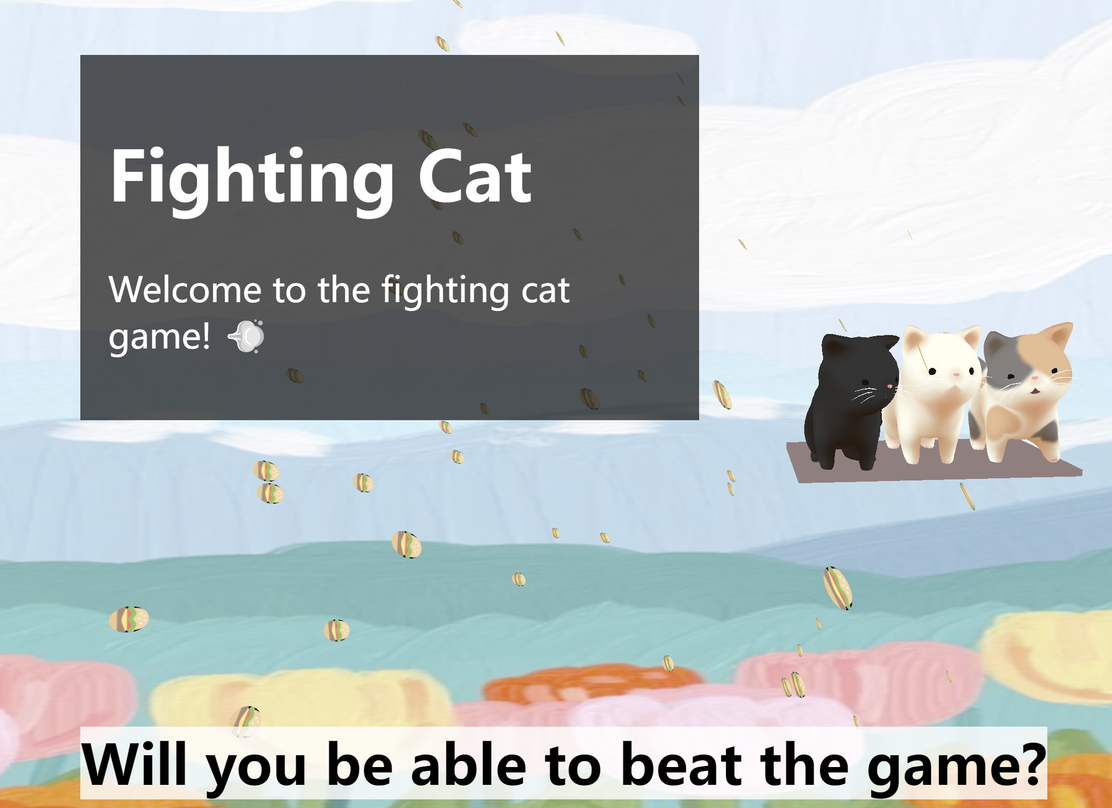
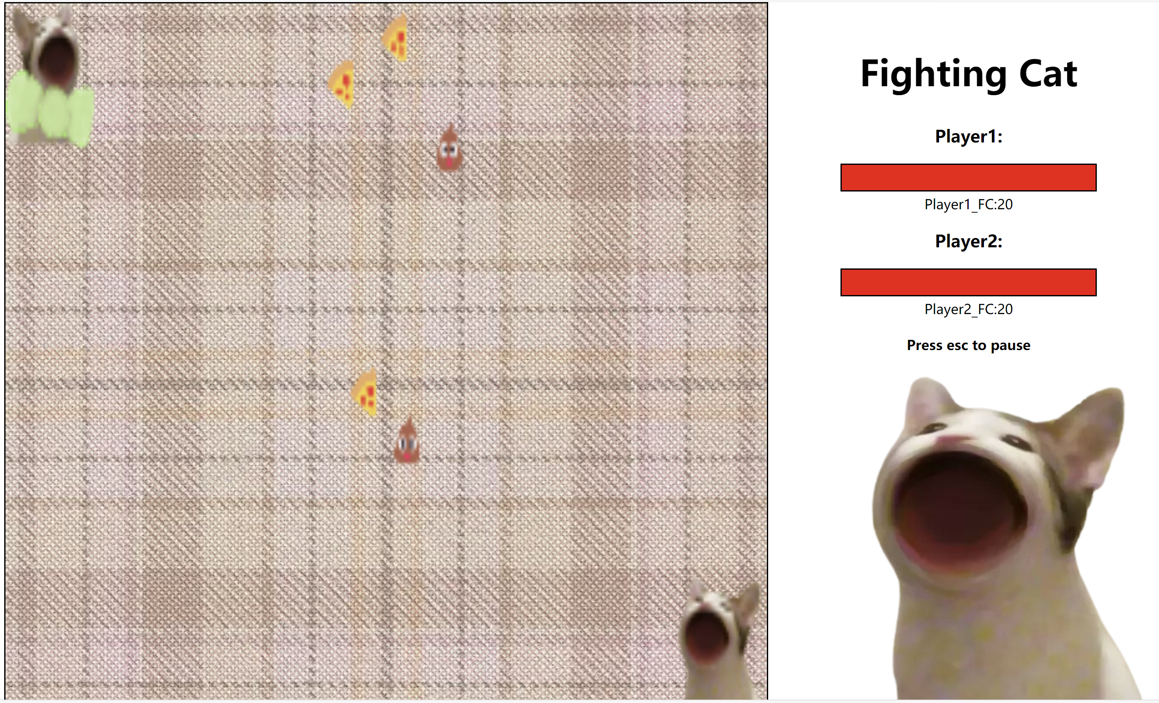
Page Effect
game page

Slide 5
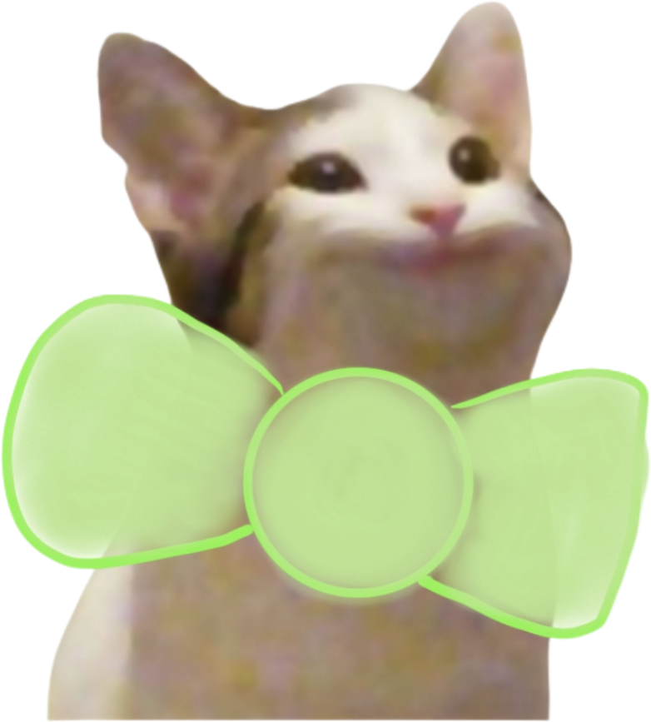
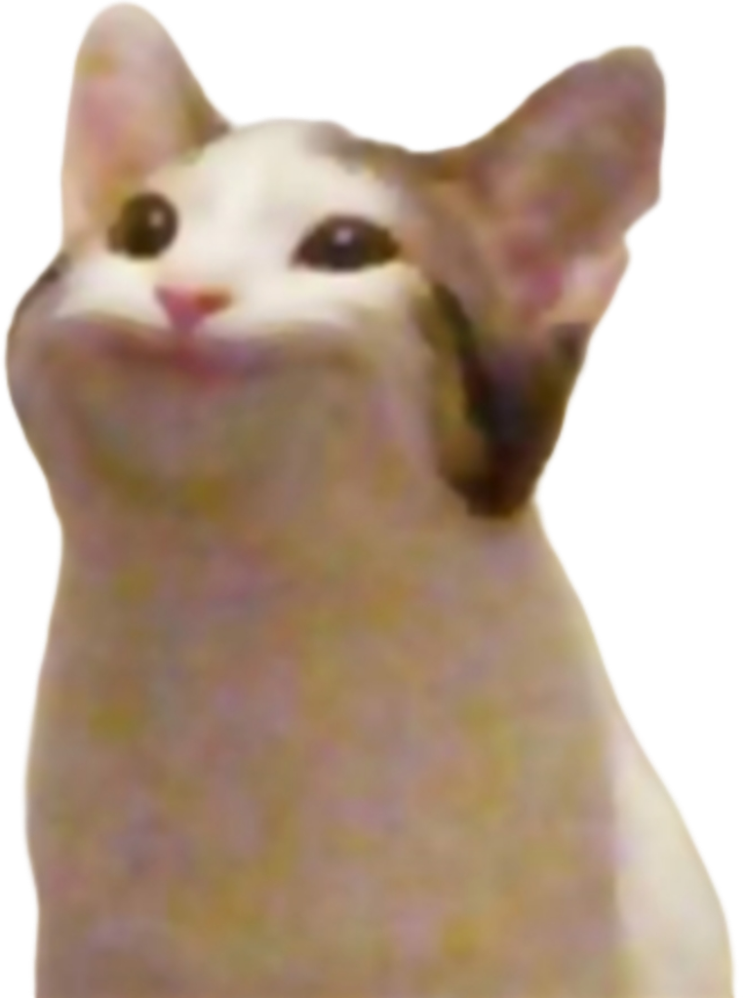
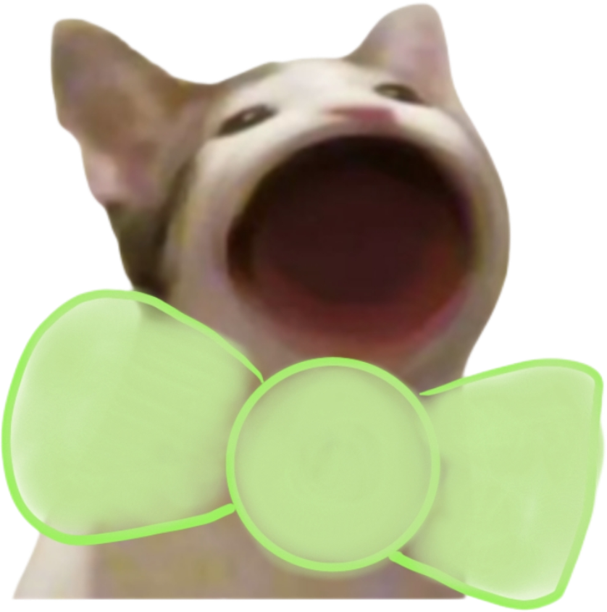
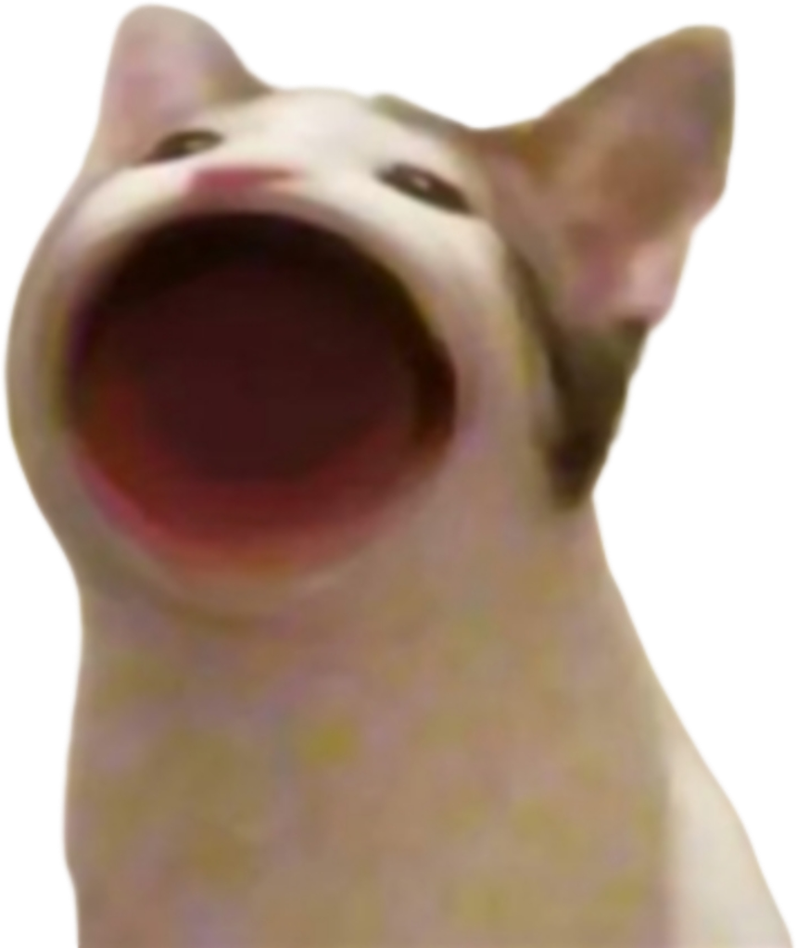
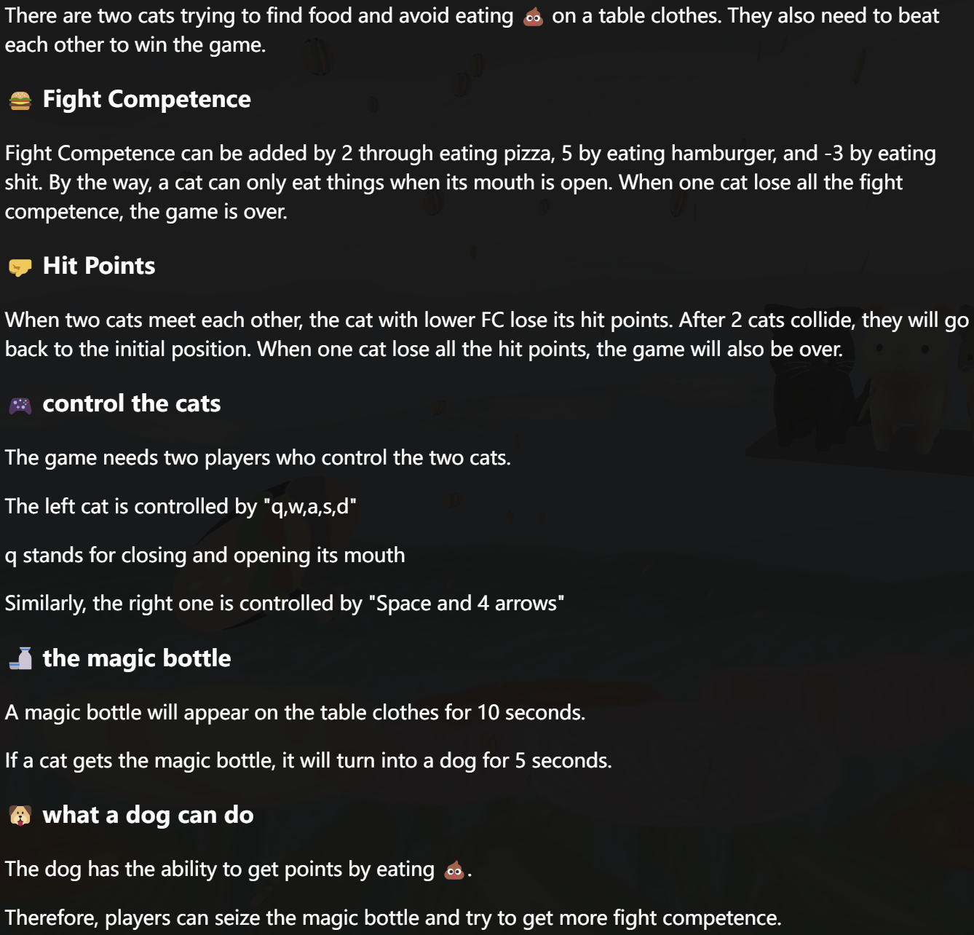



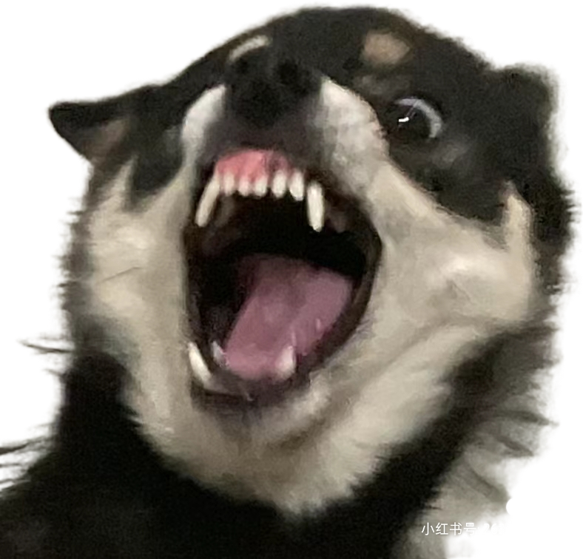
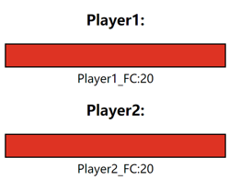
RULES
Two modes:
open mouth
closed mouth
Two Characters
Three Foods:
two foods can be eaten
one cannot be eaten
For dog, however,
All three foods can be eaten!
HP & FC

Slide 6
Game Features
During the game, the user can click the button to check the rules in case he or she forgets.
Audio
Every time the cat or dog eats the food, a specific sound is triggered.
Idea1
Idea2
The higher the difference of FC, the HP of the player with lower FC will drop more. And cat can transform into dogs for a few seconds by drinking medicine.
The game can be stopped in the process by pressing the “ESC” button.
Experience2
Experience1
Each food has different points, duration, effects, probability of appearance and random position.

Slide 7
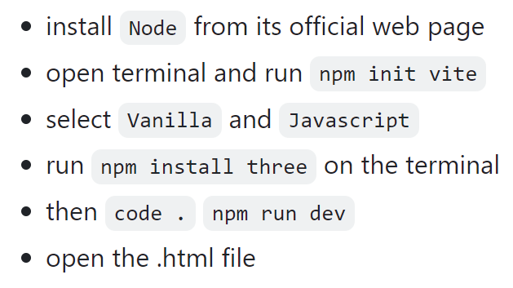
Technical Implementation
https://github.com/zhiminyi151/cat_fighting.git
Programming Languages
HTML+CSS+JavaScript
Programming Environment
IDE: Visual Studio Code
Other: npm
Running
Code Repository

Slide 8
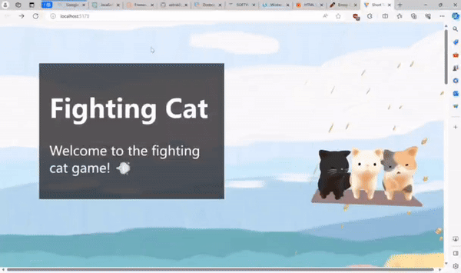
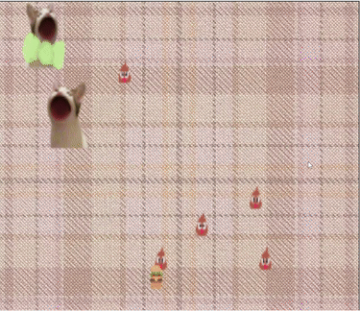
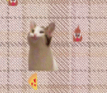
Game Demonstration
Front Page
Fighting and Collision
Closing the mouth and not eat

Slide 9
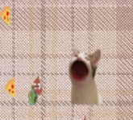
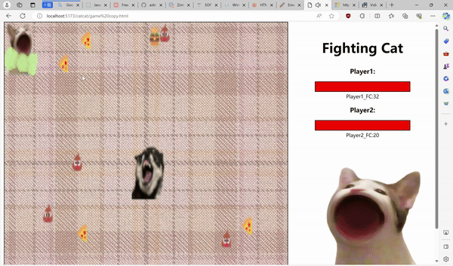
Game Demonstration
Cat turns into a dog
Dog eating and adding points

Slide 10
Game Demonstration
Now we want to show you how exactly the game works!!

Slide 11
¡Gracias!

